Slide 1
Using the TFOE transcriptional regulation network spreadsheet tool
Tige Rustad, Senior Scientist at Seattle Biomed
Email: tige.rustad@seattlebiomed.org

Slide 2
What is the TFOE network?
TFOE- transcription factor over expression
206 transcription factors (TFs) cloned into an inducible tagged expression vector
Microarrays to identify genes differentialy expressed (DE)
DE =the set of genes repressed OR induced
ChIP-seq to identify DNA bound by each TF
These two parallel approaches were published in:
Rustad & Minch et al. 2014. Mapping and manipulating the Mycobacterium tuberculosis transcriptome using a transcription factor overexpression-derived regulatory network. Genome Biology 15:502
Minch & Rustad et al. 2014. The DNA binding network of Mycobacterium tuberculosis. Nature Communications

Slide 3
What does the spreadsheet do?
Users input a gene or list of genes of interest (GOI). The spreadsheet then:
Identifies all TFs that alter expression of any of your GOI
Shows how many of your GOI are altered by each TF
Calculates the significance of the overlap between your list of genes and the set of genes altered by each TF
Identifies TFs that bind in upstream of the GOI

Slide 4
Getting started
Download and open the most recent version of the spreadsheet at :
http://networks.systemsbiology.net/mtb/content/TFOE-Searchable-Data-File
The spreadsheet should open to the tab 'ListQuery'
The spreadsheet consists of six tabs:
ListQuery- input GOI and see an overview of results
TFOE.Readout- Expression changes in your GOI for each TF
ChIP.Readout- DNA binding proximal to your GOI
TFOE.data- Expression changes triggered by TFOE and p-value of each change
ChIP.data- For each gene indicates which TFs bind directly upstream or upstream of gene earlier in the operon
Annot- Gene annotation pulled from Tuberculist and PATRIC

Slide 5
Step One: Choose your gene(s) of interest
Choose your genes of interest- at least one, up to 1,000
For this example we will use the 101 reaeration induced genes from Sherrid et al.
Genes need to be in the format from the original sequencing of the H37Rv geneome (i.e. "Rv####" with a terminal 'c' if the gene is on the Crick strand)

Slide 6
Step Two: Input your genes of interest (GOI)
Paste your genes into the blue cells
#TFOE is the number of TFs that change expression that gene
You can change the fold change and p-value considered significant by changing the values in the red cells. Default is log₂ of 1 (two fold) and pvalue ≤ 0.01
The total number of genes in your list and the number of those genes that are perturbed by at least one TF are indicated

Slide 7
Identify overlaps between GOI and each TF
DE
Calculates size and p-value of the overlap of your GOI with:
All genes DE by a TF
The TF induced genes
The TF repressed genes
The genes adjacent to TF DNA binding sites
GOI
Induced
Repressed
ChIP-Seq binding
To keep this image simple the four comparisons are not show as overlapping

Slide 8
Compare GOI and genes bound/DE by each TF
DE
GOI
GOI
Induced
Repressed
GOI
GOI
ChIP-Seq binding

Slide 9
Data types for each comparison
Number of your GOI induced/repressed/DE
Total number of genes induced/repressed/DE
Overlap expected by random chance
P-value of an overlap of the given size or larger

Slide 10
Step Three: Sort the output
Sort the TFs as desired
Each column title has an arrow that pulls up sorting options
Sorting by the significance or size of the overlap is generally the most useful view
The order of TFs in the Output table determines the order of TFs in the 'Readout' tabs

Slide 11
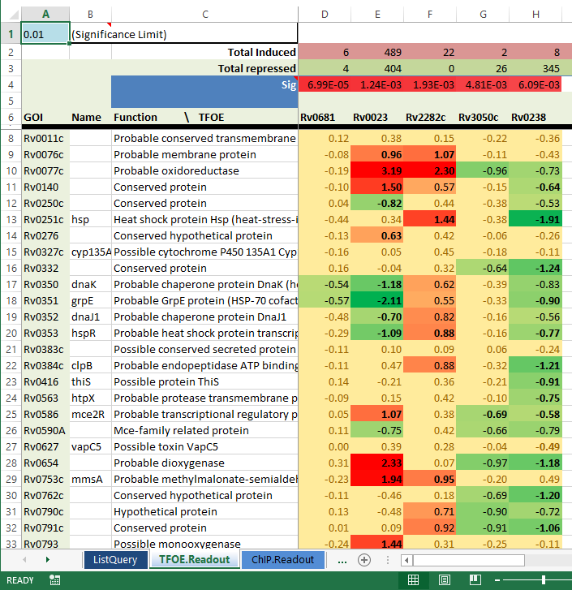
Step Four: TFOE.Readout
‘Readout’ tabs show which genes are DE for each TF
Values are log₂ values (bolded indicates p-value ≤ 0.01)
The ‘Sig’ values at the top show the p-value of the overlap between GOI and all DE genes

